Slide 1
Flutter Project
Group 2: Search & filter
Ivan apostolovski 5042
Kristijan Lazarov 5311

Slide 2
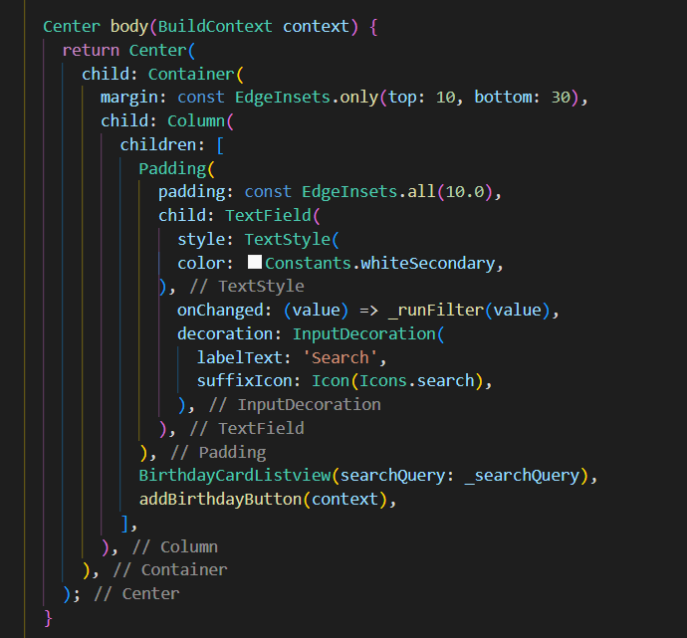
Creating a search widget and passing the search query to the BirthdayCardListview

Slide 3
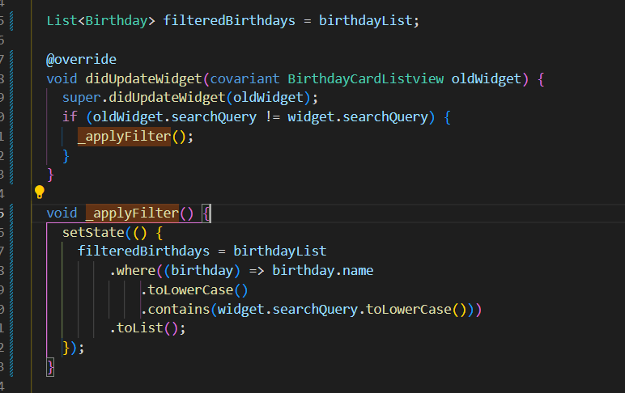
Initializing the filteredBirthdays list with the original birthdayList
Checking if the search widget has new input if it does then we apply the filter to filter out the birthdays.

Slide 4
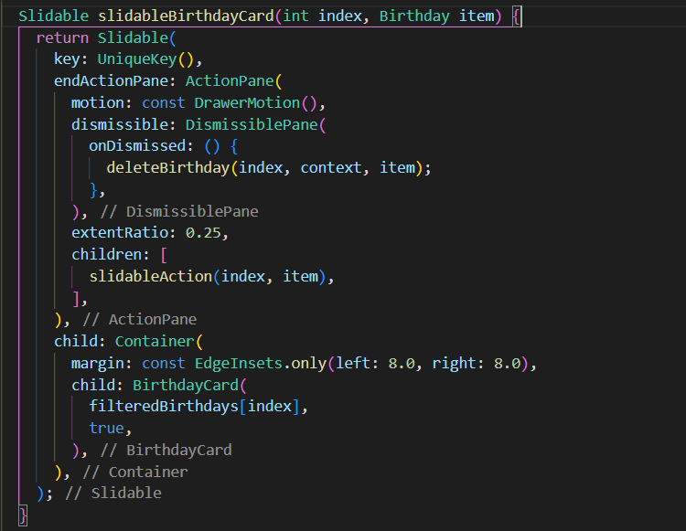
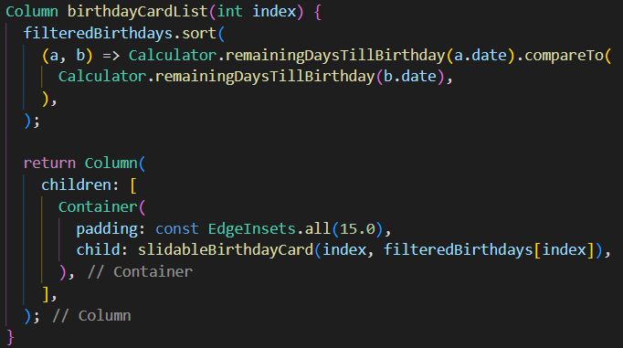
Updated the code to show the filtered birthday list

Slide 5
